Slide 1



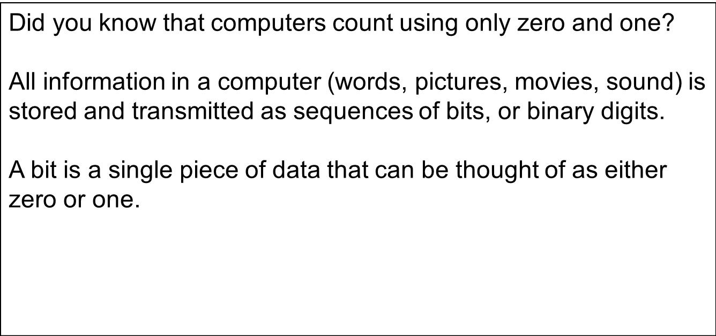

Binary Numbers
Binary Numbers
Notes:
Introductory slide to presentation.

Slide 2
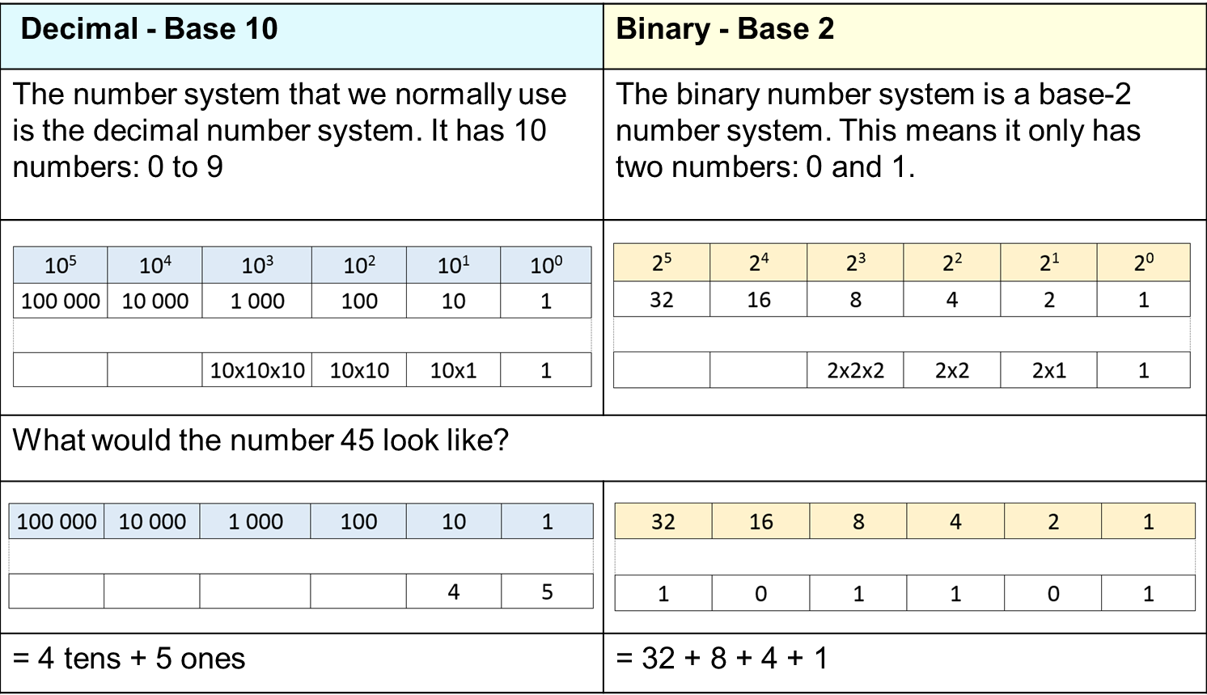
Decimal vs Binary
Notes:
Slide for discussion with students.
Note to teacher – The use of decimal numbers throughout this learning sequence does not refer to decimal numbers such as 0.2 and 3.4. Rather, it refers to our base 10 number system (decimal).

Slide 3


On and off
0 = off =
= 10
1 = on =
= 101
= 1001
Notes:
Slide for discussion with students.
Note to teacher – The use of decimal numbers throughout this learning sequence does not refer to decimal numbers such as 0.2 and 3.4. Rather, it refers to our base 10 number system (decimal).

Slide 4
STAGE 1
Creating a decimal number from a binary number
Notes:
Introductory slide to Stage 1

Slide 5
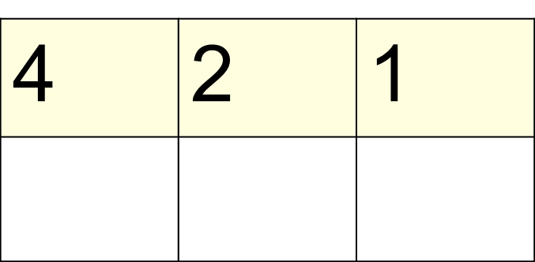
Challenge 1
Creating decimal from binary
The decimal number is ________
Notes:
Answer: 5
Working (select the number if the lamp is on) – in the box you would write 1 0 1.
Underneath the box you would show the working e.g. 4 + 1 = 5

Slide 6
Challenge 2
Creating decimal from binary
The decimal number is ________
Notes:
Answer: 6
Working (select the number if the lamp is on) – in the box you would write 1 1 0.
Underneath the box you would show the working e.g. 4 + 2 = 6

Slide 7
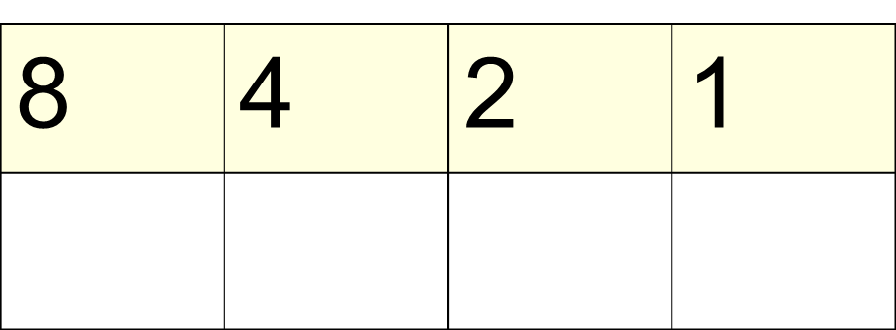
Challenge 3
Creating decimal from binary
The decimal number is ________
Notes:
Answer: 13
Working (select the number if the lamp is on) – in the box you would write 1 1 0 1.
Underneath the box you would show the working e.g. 8 + 4 + 1 = 13

Slide 8
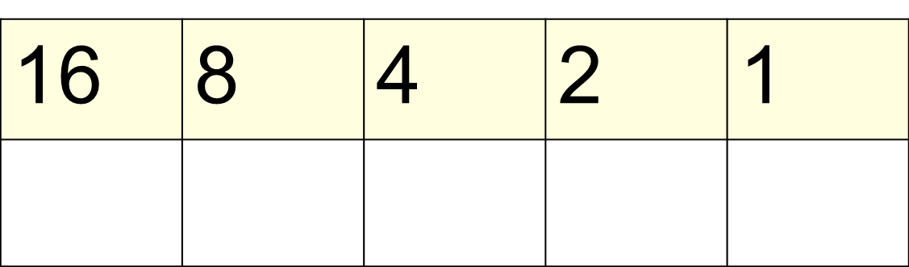
Challenge 4
Creating decimal from binary
The decimal number is ________
Notes:
Answer: 21
Working (select the number if the lamp is on) – in the box you would write 1 0 1 0 1.
Underneath the box you would show the working e.g. 16 + 4 + 1 = 21

Slide 9
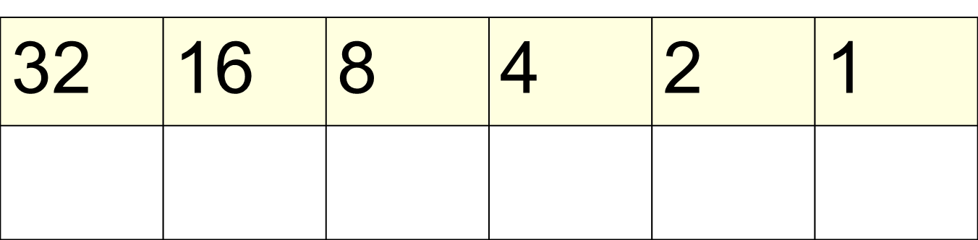
Challenge 5
Creating decimal from binary
The decimal number is ________
Notes:
Answer: 53
Working (select the number if the lamp is on) – in the box you would write 1 1 0 1 0 1.
Underneath the box you would show the working e.g. 32+ 16 + 4 + 1 = 53

Slide 10
STAGE 2
Creating a binary number from a decimal number
Notes:
Introductory slide to Stage 2

Slide 11

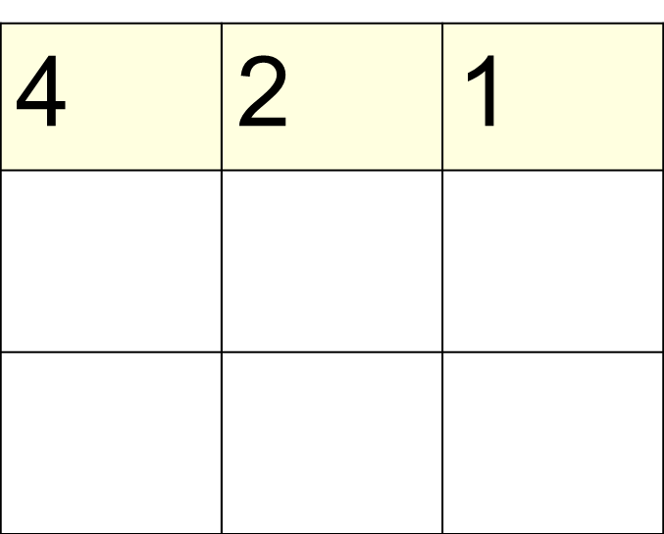

Challenge 6
Creating binary from decimal
7
The binary number is ________
Notes:
Answer: 1 1 1
Working (you could copy and paste the lamps to show on/off).
Step through each stage of working next to the box you would show the working [Note, move from biggest number to smallest]
e.g. 7 – 4 = 3 (indicates 1/on in the 4s column) 3 – 2= 1 (indicates 1/on in the 2s column) 1 – 1= 0 (indicates 1/on in the 1s column)

Slide 12
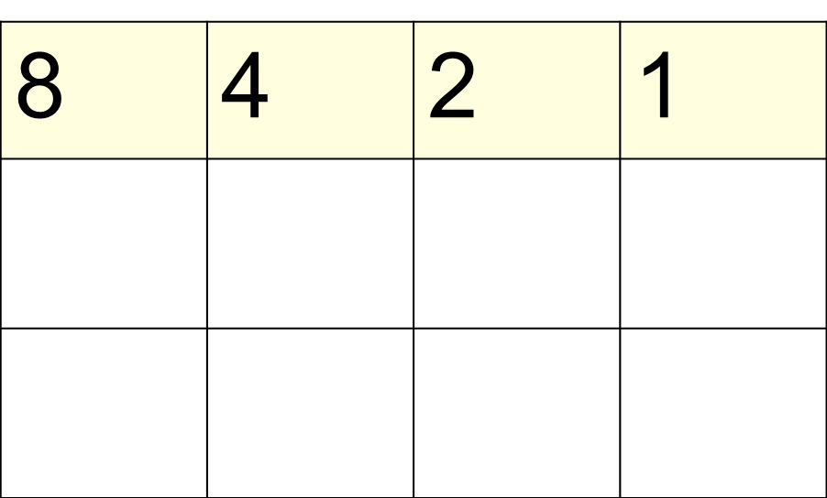
Challenge 7
Creating binary from decimal
13
The binary number is ________
Notes:
Answer: 1 1 0 1
Working (you could copy and paste the lamps to show on/off).
Step through each stage of working next to the box you would show the working [Note, move from biggest number to smallest]
e.g. 13 – 8 = 5 (indicates 1/on in the 8s column), 5 – 4= 1 (indicates 1/on in the 4s column), [Note: only left with 1 therefore cannot take away 2 so skip that level], 1 – 1= 0 (indicates 1/on in the 1s column)

Slide 13
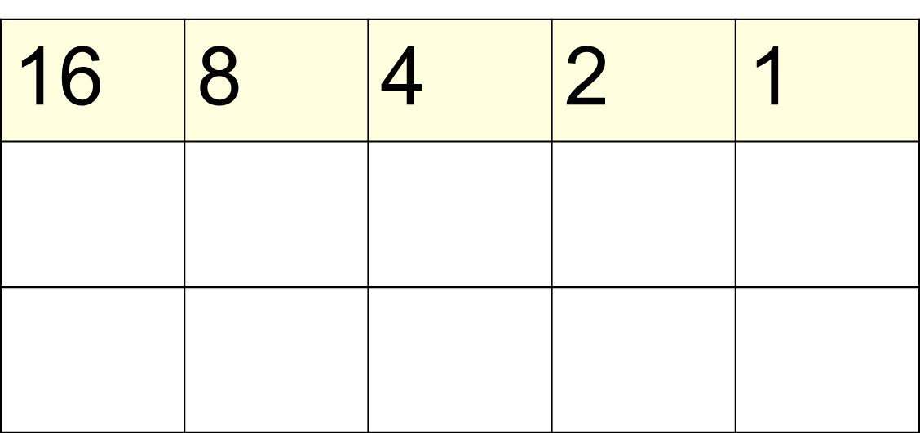
Challenge 8
Creating binary from decimal
19
The binary number is ________
Notes:
Answer: 1 0 0 1 1
Working (you could copy and paste the lamps to show on/off).
Step through each stage of working next to the box you would show the working [Note, move from biggest number to smallest]
e.g. 19 – 16 = 3 (indicates 1/on in the 16s column), [Note: only left with 3 therefore cannot take away 8 nor 4 so skip those levels] 3 – 2= 1 (indicates 1/on in the 2s column), 1 – 1= 0 (indicates 1/on in the 1s column)

Slide 14
Challenge 9
Creating binary from decimal
27
The binary number is ________
Notes:
Answer: 1 1 0 1 1
Working (you could copy and paste the lamps to show on/off).
Step through each stage of working next to the box you would show the working [Note, move from biggest number to smallest]
e.g. 27 – 16 = 11 (indicates 1/on in the 16s column), 11 – 8= 3 (indicates 1/on in the 8s column), [Note: only left with 3 therefore cannot take away 4 so skip that level], 3 – 2= 1 (indicates 1/on in the 2s column), 1 – 1= 0 (indicates 1/on in the 1s column)

Slide 15
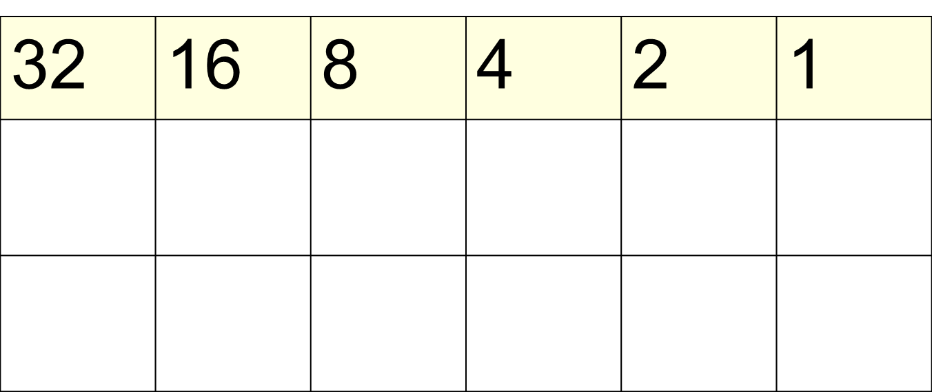
Challenge 10
Creating binary from decimal
45
The binary number is ________
Notes:
Answer: 1 0 1 1 0 1
Working (you could copy and paste the lamps to show on/off).
Step through each stage of working next to the box you would show the working [Note, move from biggest number to smallest]
e.g. 45 – 32 = 13 (indicates 1/on in the 32s column), [Note: only left with 13 therefore cannot take away 21 so skip that level], 13 – 8 = 5 (indicates 1/on in the 8s column), 5 – 4= 1 (indicates 1/on in the 4s column), [Note: only left with 1 therefore cannot take away 2 so skip that level], 1 – 1= 0 (indicates 1/on in the 1s column)

Slide 16
Challenge 11
Creating binary from decimal
58
The binary number is ________
Notes:
Answer: 1 1 1 0 1 0
Working (you could copy and paste the lamps to show on/off).
Step through each stage of working next to the box you would show the working [Note, move from biggest number to smallest]
e.g. 58 – 32 = 26 (indicates 1/on in the 32s column), 26 – 16 = 10 (indicates 1/on in the 16s column), 10 – 8 = 2 (indicates 1/on in the 8s column), [Note: only left with 2 therefore cannot take away 4 so skip that column value], 2 – 2 = 0 (indicates 1/on in the 2s column), [Note: none left therefore cannot make use of the 1 column value].

