Slide 1

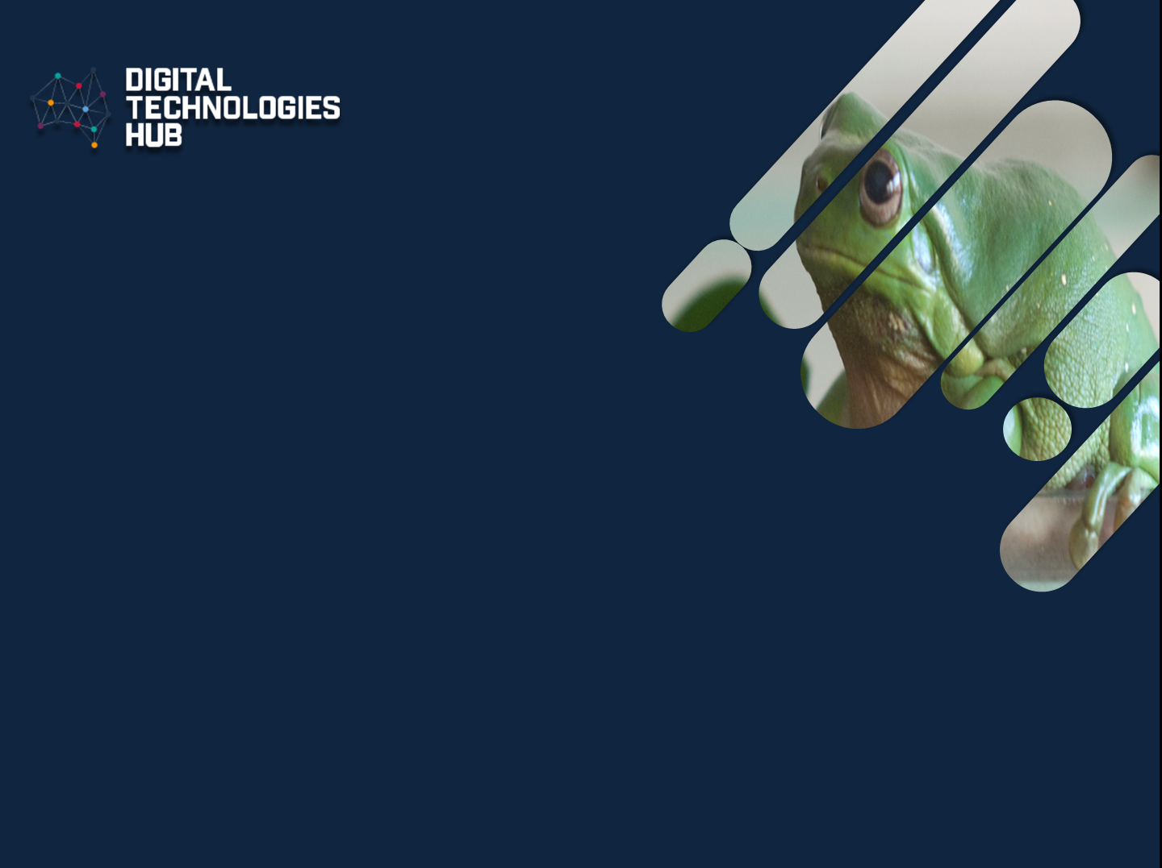

My favourite animal
Digital Technologies Hub is brought to you by the Australian Government Department of Education. Creative Commons Attribution 4.0, unless otherwise indicated.
Notes:
Source M. Richards

Slide 2
Info about my favourite animal
I'm sharing information about my favourite animal.
I used different types of data to represent my animal.
I used different digital devices to create my presentation.
Digital Technologies Hub is brought to you by the Australian Government Department of Education. Creative Commons Attribution 4.0, unless otherwise indicated.

Slide 3
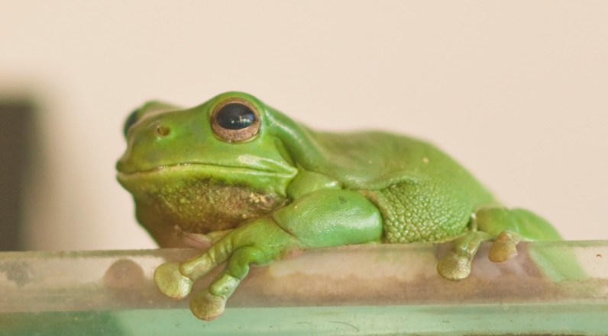
Data as an image
Image taken using a tablet with a camera.
Digital Technologies Hub is brought to you by the Australian Government Department of Education. Creative Commons Attribution 4.0, unless otherwise indicated.
Notes:
Source M. Richards

Slide 4
Data as text
Common name: Green Tree Frog
Scientific name (Litoria caerulea)
An adult Australian Green Tree Frog, with a weight range of 60 to 120 grams, a bit less than a medium-sized apple.
Indigenous to Australia, they inhabit diverse environments, including rainforests, swamps, suburban gardens, and human-made structures near water.
In the wild, they are nocturnal hunters, their diet consists of insects and small invertebrates. They use their sticky tongue and large toe pads for catching prey and climbing.
Text typed with the computer keyboard
Digital Technologies Hub is brought to you by the Australian Government Department of Education. Creative Commons Attribution 4.0, unless otherwise indicated.

Slide 5
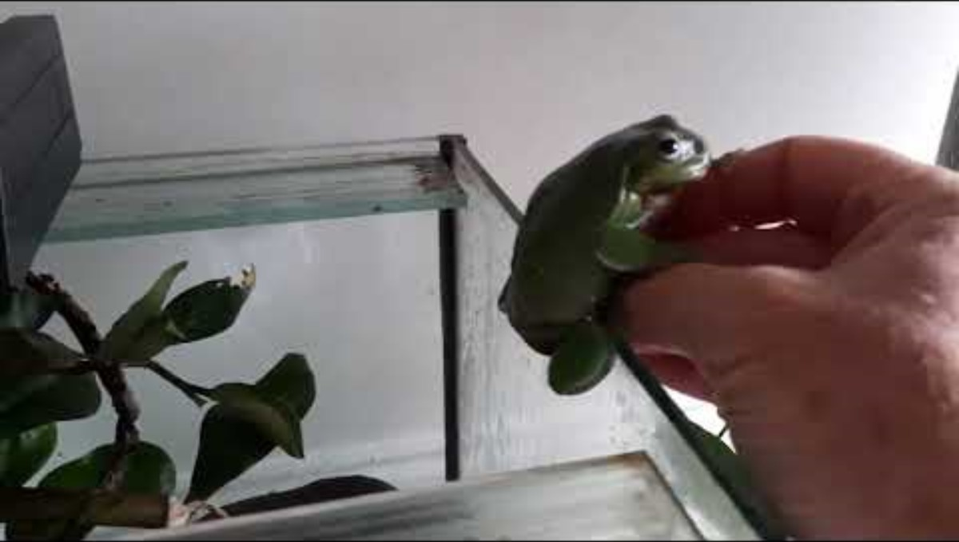
Data as video
Video taken using a tablet with a camera
Digital Technologies Hub is brought to you by the Australian Government Department of Education. Creative Commons Attribution 4.0, unless otherwise indicated.
Notes:
https://youtu.be/hNY3Whp4uKo
Use video link if embedded video does not work

Slide 6

Data as sound
The calls of the Australian Green Tree Frog sound like a series of deep squelching 'crawk-crawk-crawk-crawk…' calls.
Have a listen to this audio file.
Sound recorded with the internal microphone of a tablet device.
Digital Technologies Hub is brought to you by the Australian Government Department of Education. Creative Commons Attribution 4.0, unless otherwise indicated.

Slide 7
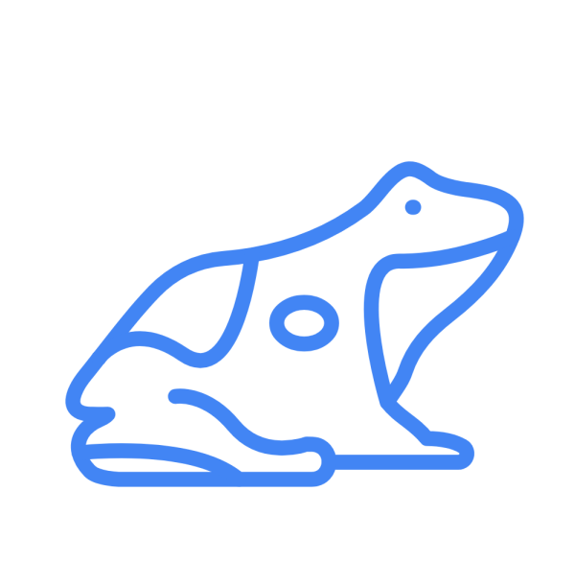
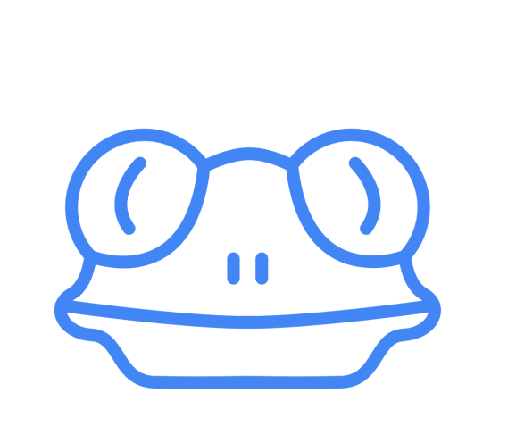
My drawing
Image drawn with Autodraw
Digital Technologies Hub is brought to you by the Australian Government Department of Education. Creative Commons Attribution 4.0, unless otherwise indicated.
Notes:
Image drawn with Autodraw https://www.autodraw.com

Slide 8
Your favourite animal
Share information about your favourite animal.
Use different types of data to represent your animal.
Consider what digital devices you can use to create your presentation.
Digital Technologies Hub is brought to you by the Australian Government Department of Education. Creative Commons Attribution 4.0, unless otherwise indicated.
Notes:
Source https://upload.wikimedia.org/wikipedia/commons/1/1c/Melbourne_suburban_and_regional_rail_symbols.png
Symbols are used to represent trains

