Slide 1
First Nations Australian instructive games
Creating an algorithm for the game Kolap

Slide 2
Creating an algorithm
Getting ready
Requirements
Instructions
Formulating an algorithm
Start line
Target
Bean bags (kolaps)
Two players
Start
Place the target mat on the ground.
Each player stands behind a line.
Notes:
Focus on each stage.
Discuss the requirements.
Work through how to formulate a sequence of steps that can be used to play the game Kolap.

Slide 3
Score set up
Score set up
Requirements
Instructions
Formulating an algorithm
Scoreboard with player name/team name and initial score
Both players start with a score of 0.
Notes:
Focus on each stage.
Discuss the requirements.
Work through how to formulate a sequence of steps that can be used to play the game kolap.

Slide 4
Taking turns
Turns and attempts
Requirements
Instructions
Formulating an algorithm
Start with Player A.
[Player A throws a bean bag (kolap).] Repeat 4 times.
Is Player A finished? IF Yes, THEN it’s Player B’s turn.
[Player B throws a bean bag (kolap).] Repeat 4 times.
Is Player B finished? IF Yes, THEN it’s Player A’s turn.
Players take turns: Player A goes first, then Player B.
Each player has 4 chances to throw the bean bag (kolap).
Notes:
Focus on each stage.
Discuss the requirements.
Work through how to formulate a sequence of steps that can be used to play the game kolap.
This is an example of iteration then branching using if/then statements.

Slide 5
Turns and scoreboard
Player’s turn
Requirements
Instructions
Formulating an algorithm
Scoreboard with player name/team name initial score
When it’s your turn, toss the bean bag.
IF it fully lands on the mat, THEN add one point to your score.
ELSE (if it doesn’t land on the mat), don’t add a point.
Notes:
Focus on each stage.
Discuss the requirements.
Work through how to formulate a sequence of steps that can be used to play the game kolap.
This is an opportunity to discuss branching and how we use If/then statements.

Slide 6
Updating the score
Score updates
Instructions
Formulating an algorithm
Scoreboard with player name/team name initial score
Add one point to player score IF the land a bean bag (kolap) fully on the mat.
Is it a winning score?
Is the total score = 20? IF Yes, stop the game. The Winner is the Player who is first to reach 20 points.
ELSE continue to play.
Notes:
Focus on each stage.
Discuss the requirements.
Work through how to formulate a sequence of steps that can be used to play the game kolap.
This is an opportunity to discuss branching and how we use If/then statements.

Slide 7
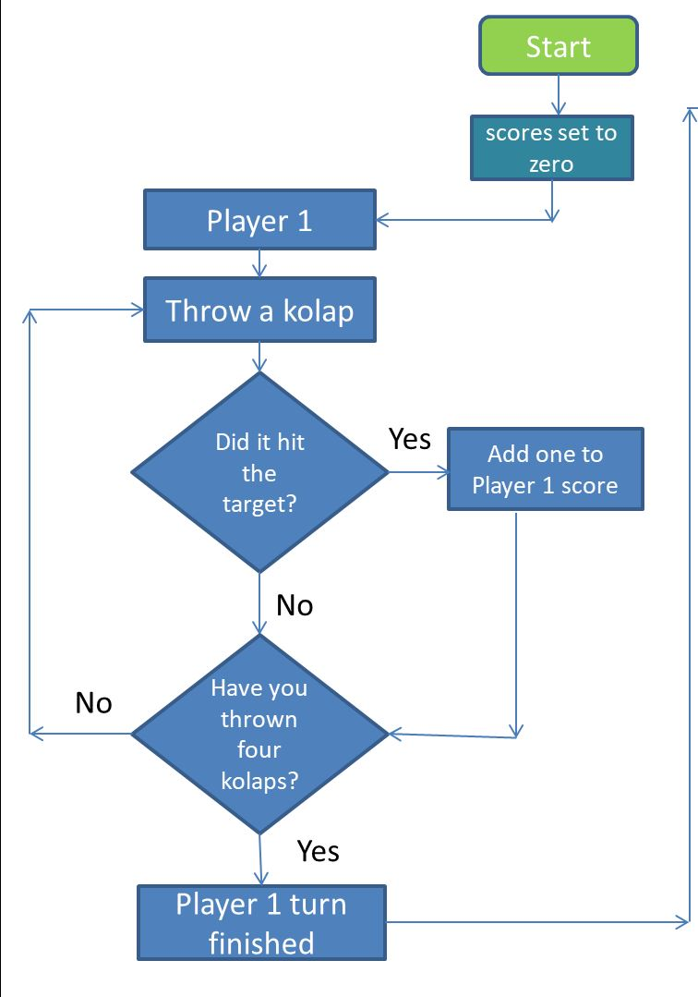
Sample flowchart one player
Notes:
You may want to use this sample flow chart for students to follow.
Run through the steps with a student role playing player 1 following the steps.
What happens when player 1 finishes?

Slide 8
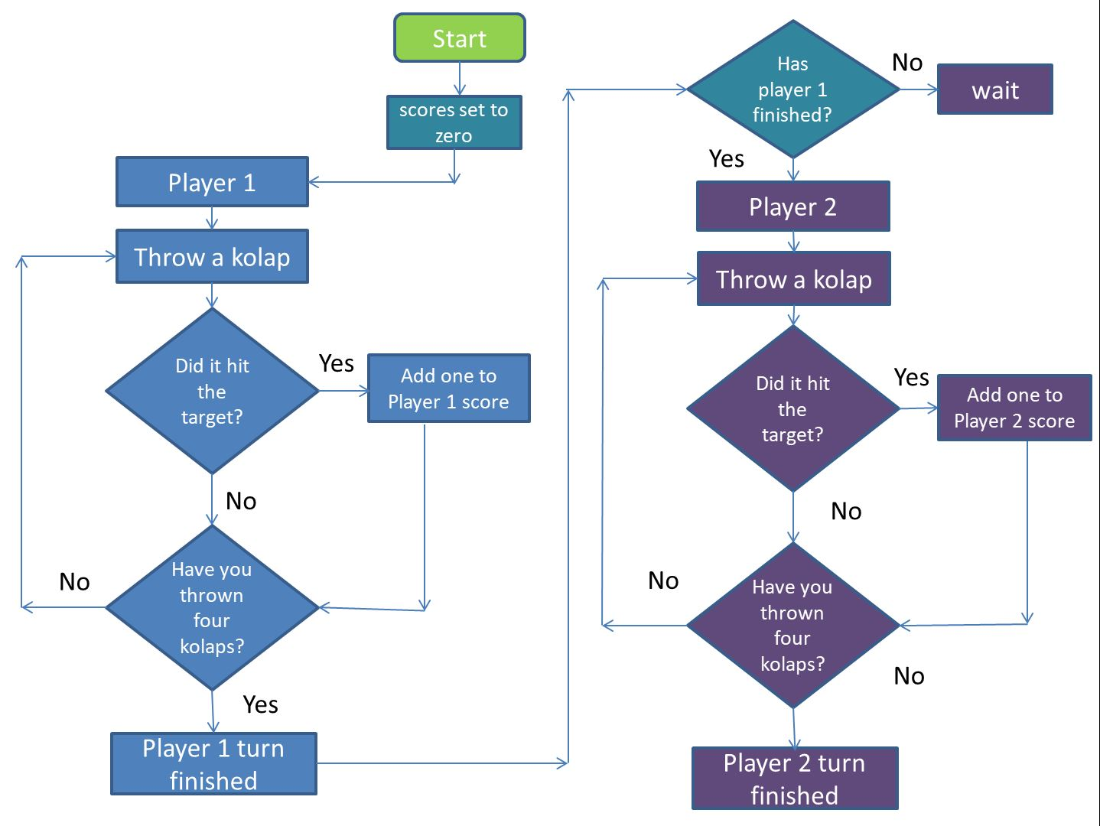
Sample flowchart two players
Notes:
You may want to use this sample flow chart for students to follow.
How can it be improved? (You could have repeat until for the 4 throws)
What is missing? (Comparing scores.) Does the score equal 20? Continue until a player reaches a score of 20

