Slide 1
Game design
Create your own mini-game: programming tips
Years 3–4
Digital Technologies Hub is brought to you by the Australian Government Department of Education. Creative Commons Attribution 4.0, unless otherwise indicated.

Slide 2
Coding tips
When designing a mini-game, you will use your programming skills to control character movement, create interactive events and switch between scenes.
These slides provide code examples to:
change backdrops
move a sprite (character)
trigger an event if two sprites touch.
Digital Technologies Hub is brought to you by the Australian Government Department of Education. Creative Commons Attribution 4.0, unless otherwise indicated.

Slide 3
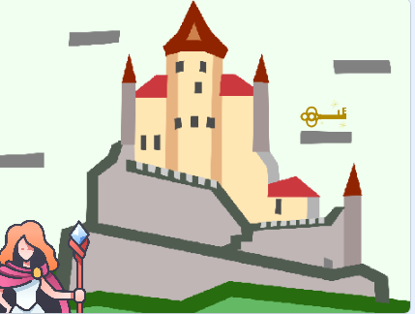
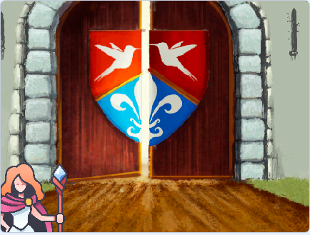
Switching between different scenes
In some games the goal is to collect something, such as in this game, where the magician collects a key.
After completing the task, the magician reaches the castle doors.
What blocks would you use to code the program?
If the magician touches the key, then move to the castle doors.
Image: Flaticon.com
Digital Technologies Hub is brought to you by the Australian Government Department of Education. Creative Commons Attribution 4.0, unless otherwise indicated.
Notes:
Scratch code example castle https://scratch.mit.edu/projects/1049915172/editor
This code is for the sprite: treasure.

Slide 4
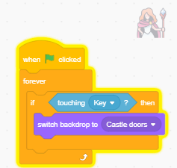
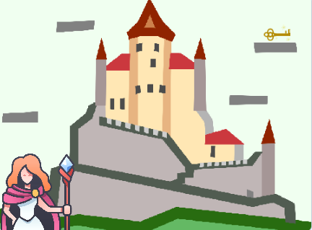
Switching between different scenes: code
Use an event to trigger the change in backdrop.
The program shows:
when green flag is clicked
an If/Then block with a blue sensing block 'touching Key’
activates a purple block to switch backdrops
and the program is within a forever block.
To start the program, click the green flag. If the magician touches the key, then switch backdrop to Castle doors.
You would also need to code the magician's movement.
Image: Flaticon.com
Digital Technologies Hub is brought to you by the Australian Government Department of Education. Creative Commons Attribution 4.0, unless otherwise indicated.
Notes:
Scratch code example castle https://scratch.mit.edu/projects/1049915172/editor
This code is for the sprite: treasure
A forever block is used so the If/Then block is activated to continuously run while the program is running.

Slide 5
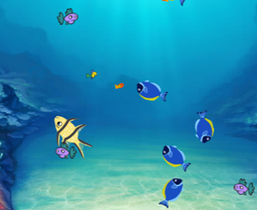
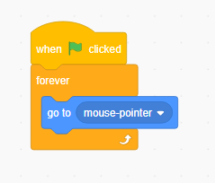
Introducing movement: make a sprite follow the mouse pointer
Hungry fish
Imagine a game where the hungry fish needs to catch the small orange fish but avoid the bigger fish.
You can make a sprite
follow the mouse pointer.
Image: Flaticon.com
Digital Technologies Hub is brought to you by the Australian Government Department of Education. Creative Commons Attribution 4.0, unless otherwise indicated.
Notes:
Fish chomp
https://scratch.mit.edu/projects/1017263093/editor/

Slide 6
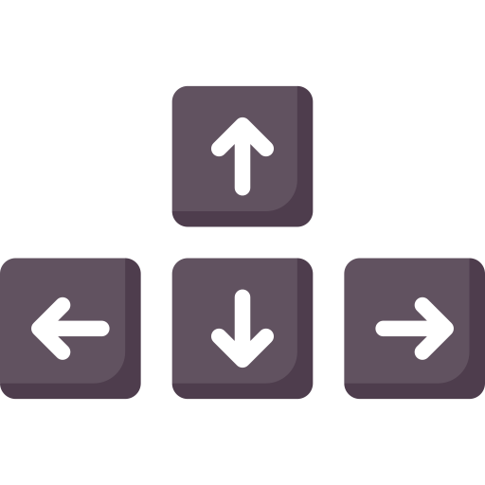
Using arrow keys to control a sprite
A sprite’s movement can be programmed to be controlled by the arrow keys.
Images: Flaticon.com
Digital Technologies Hub is brought to you by the Australian Government Department of Education. Creative Commons Attribution 4.0, unless otherwise indicated.
Notes:
A sprite’s movement can be programmed to be controlled by the arrow keys.

Slide 7
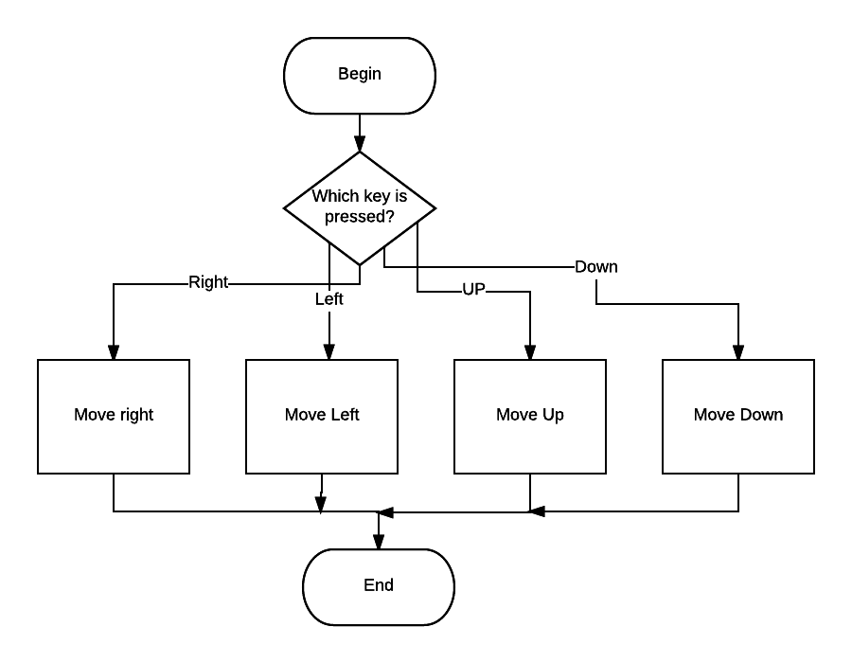
A flowchart representing the use of arrow keys to control a sprite
Images: Flaticon.com
Digital Technologies Hub is brought to you by the Australian Government Department of Education. Creative Commons Attribution 4.0, unless otherwise indicated.
Notes:
We can show that using a flowchart.

Slide 8
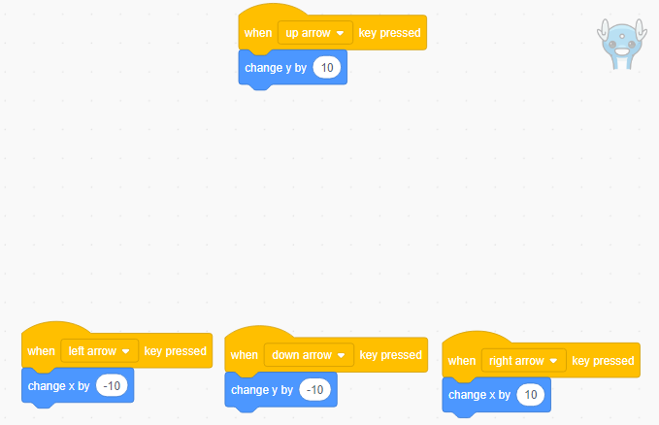
Using arrow key pressed blocks to control a sprite
Images: Flaticon.com
Digital Technologies Hub is brought to you by the Australian Government Department of Education. Creative Commons Attribution 4.0, unless otherwise indicated.

Slide 9
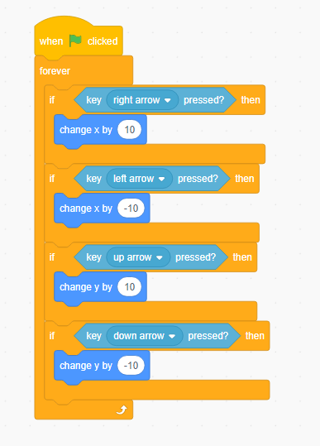
Another way: arrow key pressed using If/Then blocks
Image: Flaticon.com
Digital Technologies Hub is brought to you by the Australian Government Department of Education. Creative Commons Attribution 4.0, unless otherwise indicated.

Slide 10
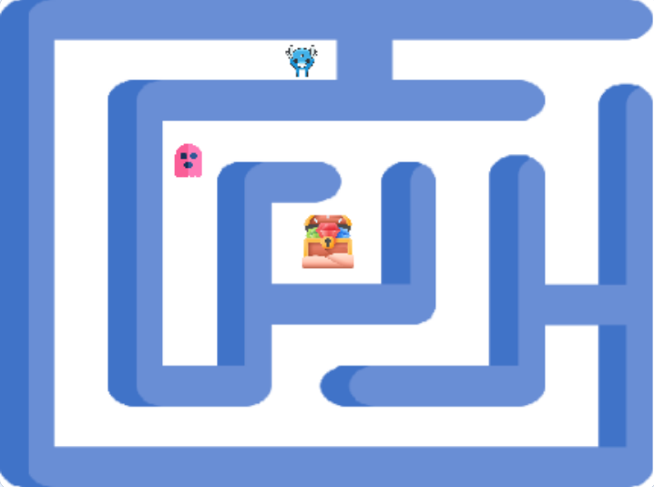
Using glide blocks to move a sprite from one position to another
Imagine a maze game where we want the ghost to move automatically within the maze.
You can use the glide blocks and adjust the x and y coordinates.
Adjust the time in seconds to speed up or slow the movement.
Image: Flaticon.com
Digital Technologies Hub is brought to you by the Australian Government Department of Education. Creative Commons Attribution 4.0, unless otherwise indicated.
Notes:
This code moves the sprite around the maze.
https://scratch.mit.edu/projects/1047742432/editor
Set up coordinates: Determine the x and y coordinates for different points within the maze where you want the ghost to glide.
Create a path: Use multiple glide blocks to create a sequence of movements that will navigate the ghost through the maze.

Slide 11
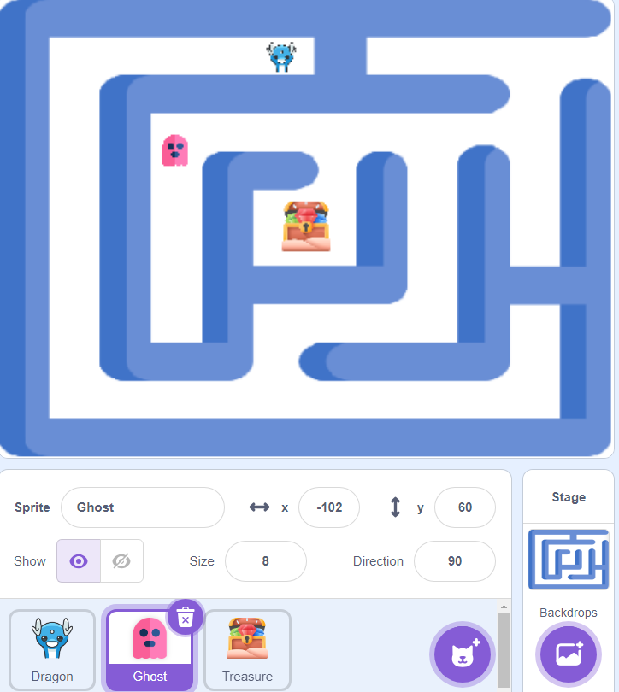
Using glide blocks
Image: Flaticon.com
Digital Technologies Hub is brought to you by the Australian Government Department of Education. Creative Commons Attribution 4.0, unless otherwise indicated.
Notes:
This code moves the sprite around the maze.
https://scratch.mit.edu/projects/1047742432/editor
Set up coordinates: Determine the x and y coordinates for different points within the maze where you want the ghost to glide.
Create a path: Use multiple glide blocks to create a sequence of movements that will navigate the ghost through the maze.

Slide 12
If touching colour
Start position (x: -19, y: 133)
In this game, we need to keep the dragon within the maze.
If the dragon touches the colour , then move back to start (x: -19, y: 133).
Image: Flaticon.com
Digital Technologies Hub is brought to you by the Australian Government Department of Education. Creative Commons Attribution 4.0, unless otherwise indicated.

Slide 13
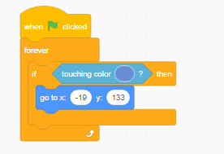
Code example: if touching colour
Start position (x: -19, y: 133)
Image: Flaticon.com
Digital Technologies Hub is brought to you by the Australian Government Department of Education. Creative Commons Attribution 4.0, unless otherwise indicated.
Notes:
One way to code the sprite is to use an If/Then block.
Using a sensing block ‘touching colour’, we change the colour to match the maze wall exactly using the eyedropper tool.
We add a motion block go to (x, y) and add the coordinates.
The code is nested in a forever block, so it works continuously when the program is running.

Slide 14
Detect when one sprite touches another
In games, we often trigger an event if one sprite touches another.
Specify the action to take when the sprites touch.
In this maze game, if the ghost touches the dragon, then game over.
Image: Flaticon.com
Digital Technologies Hub is brought to you by the Australian Government Department of Education. Creative Commons Attribution 4.0, unless otherwise indicated.

Slide 15
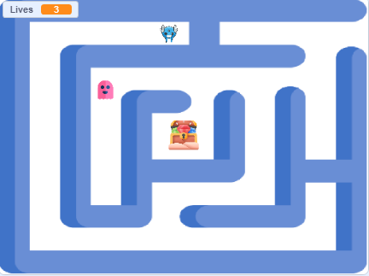
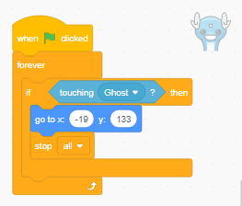
Detect when one sprite touches another: code
Image: Flaticon.com
Digital Technologies Hub is brought to you by the Australian Government Department of Education. Creative Commons Attribution 4.0, unless otherwise indicated.
Notes:
This is a simple script that students can use as a starting point.

Slide 16
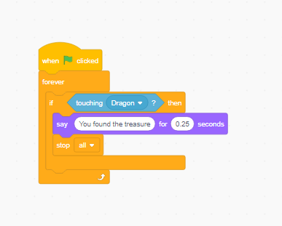
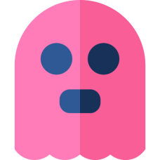
Match the code to the sprite
or
or
Image: Flaticon.com
Digital Technologies Hub is brought to you by the Australian Government Department of Education. Creative Commons Attribution 4.0, unless otherwise indicated.
Notes:
Scratch code example maze game https://scratch.mit.edu/projects/1047742432/editor
Answer: This code is for the sprite 'treasure’.

Slide 17
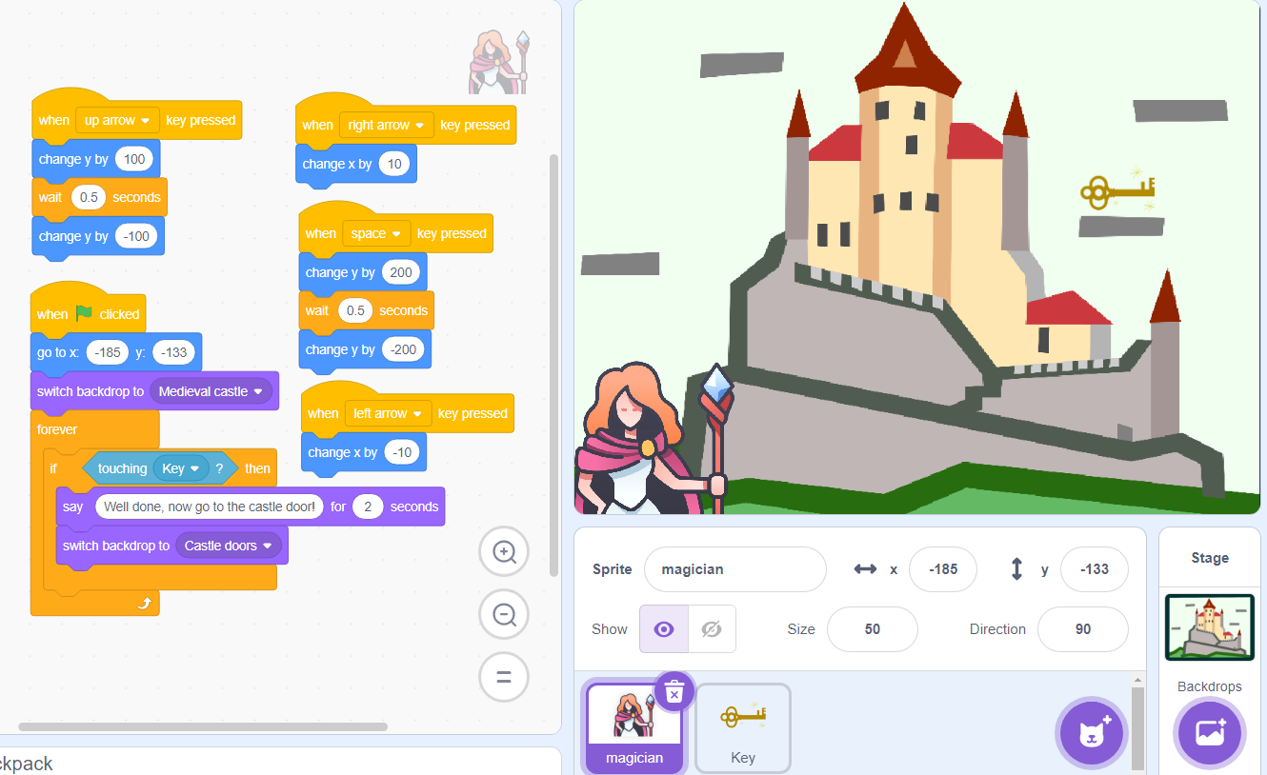
Match the code to the sprite
Image: Flaticon.com
Digital Technologies Hub is brought to you by the Australian Government Department of Education. Creative Commons Attribution 4.0, unless otherwise indicated.
Notes:
Scratch code example: Castle and key https://scratch.mit.edu/projects/1053260956/editor
This code is for the sprite: magician.
Once students have a chance to predict what the code does, play the game pasting the URL in a browser.
Predicting what a code does is a useful skill to develop. Use this code to predict what will happen in the game.
Which blocks control movement?
Answer: When 'up arrow' key pressed movement is changed up by 10. Right- and left-hand movement is controlled by right arrow pressed and left arrow pressed.
Note: the space bar makes the magician jump to the top of screen.
Discuss what event is triggered if the magician touches the key.
Answer: The magician says, ‘Well done, now go to the castle door.’ The backdrop switches to Castle door.
If remixing this program, students could make the key say, 'Well done, now go to the castle door.'
They could also program the key to move randomly to one of the other three rectangular shapes in the sky.

