Slide 1
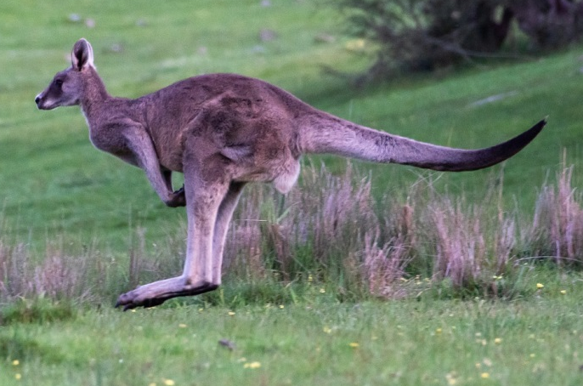

Slide 2
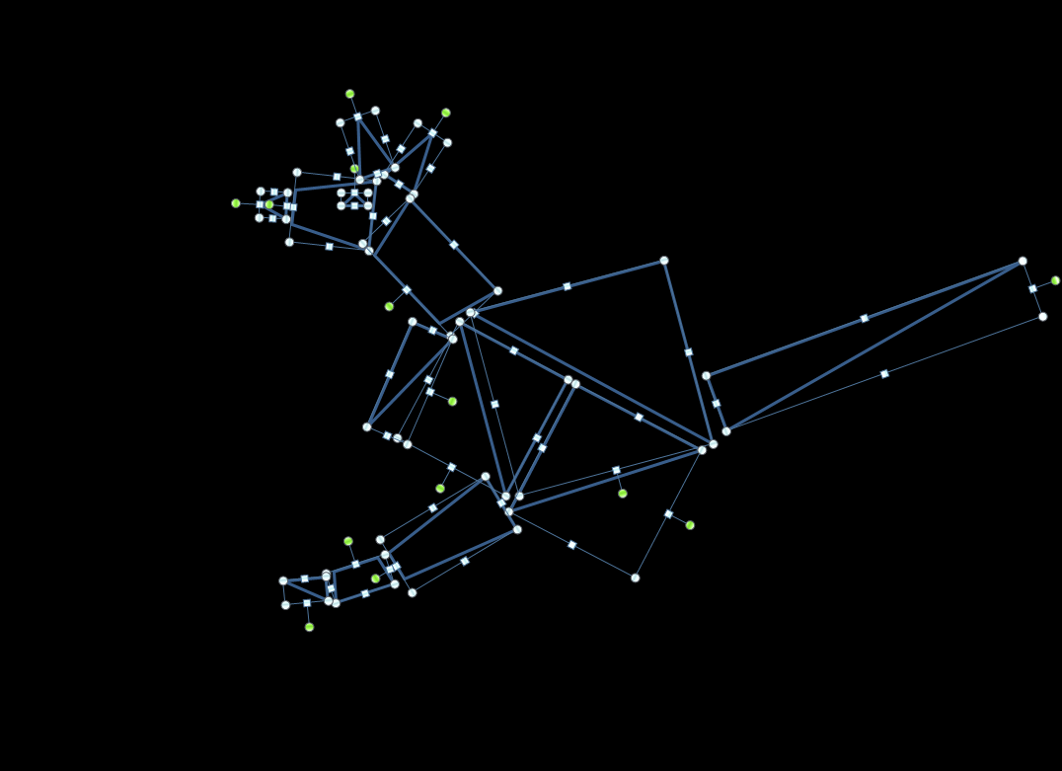
This is how a computer might ‘see’ the kangaroo made up of different shapes

Slide 3
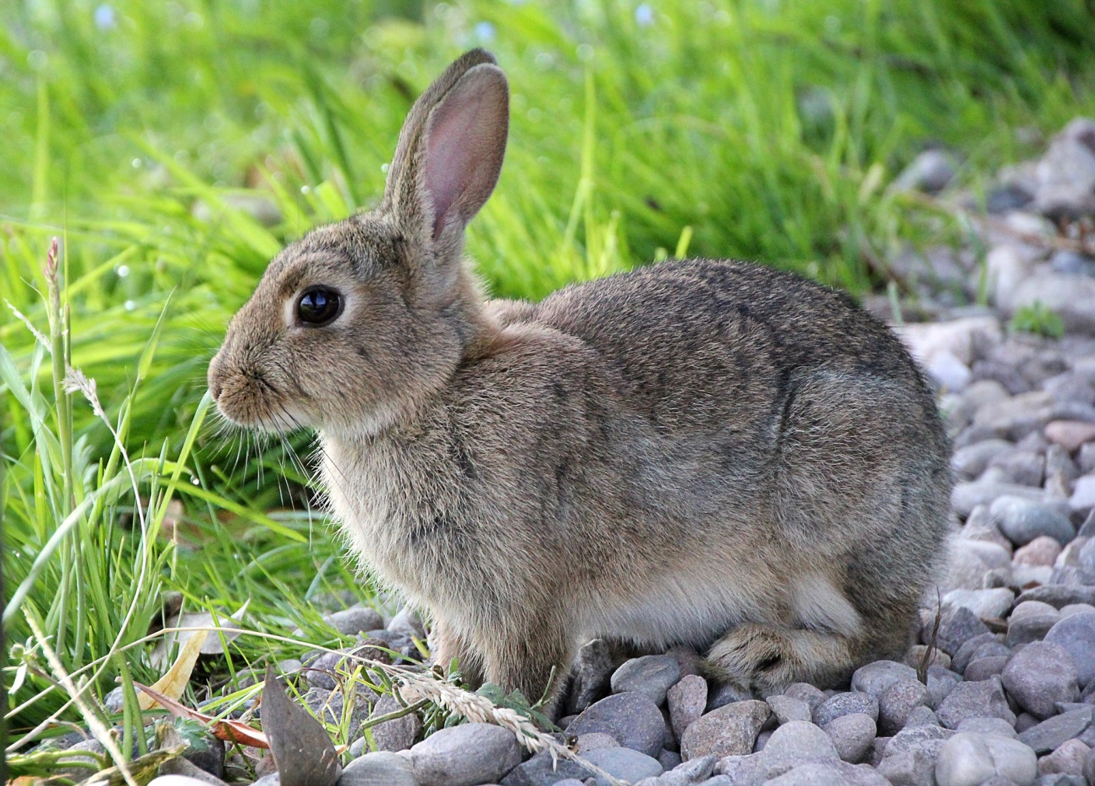

Slide 4
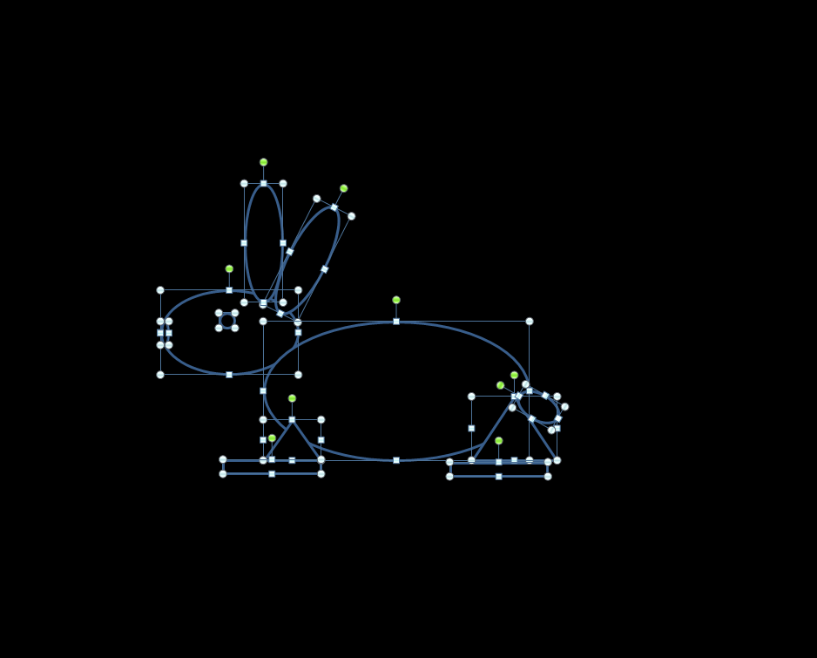
This is how a computer might ‘see’ the rabbit made up of different shapes

Slide 5
How might these shapes be combined to represent an animal?
See if you can guess as the shapes are arranged on next slide.

Slide 7
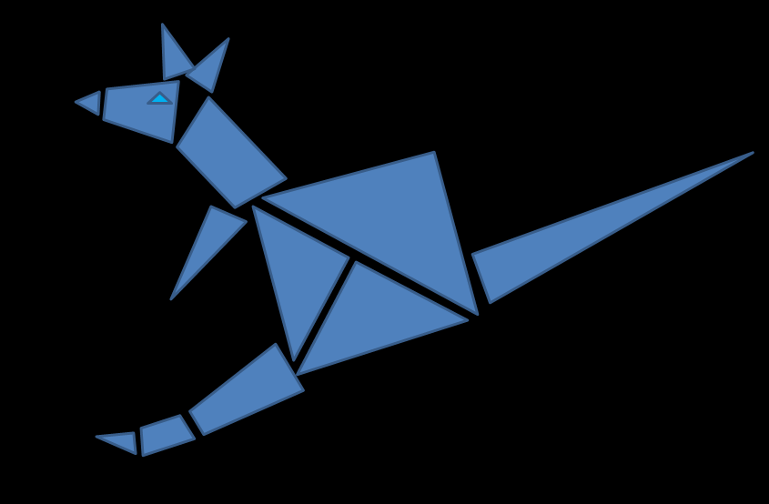
Your task
Try to create a pattern of the features of an animal or object.
See if your friend can guess what it is.

