Slide 1
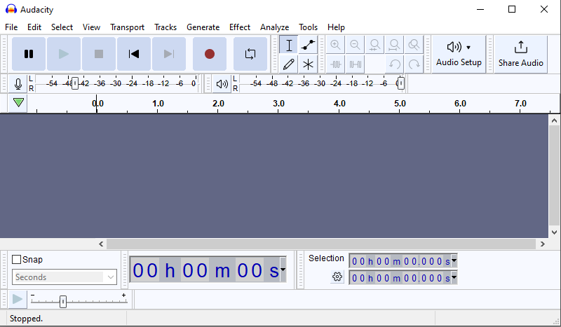


Creating and manipulating sound waves

Slide 2
Manipulating sound waves
Use Audacity software or a similar tool to create and manipulate sound waves.

Slide 3
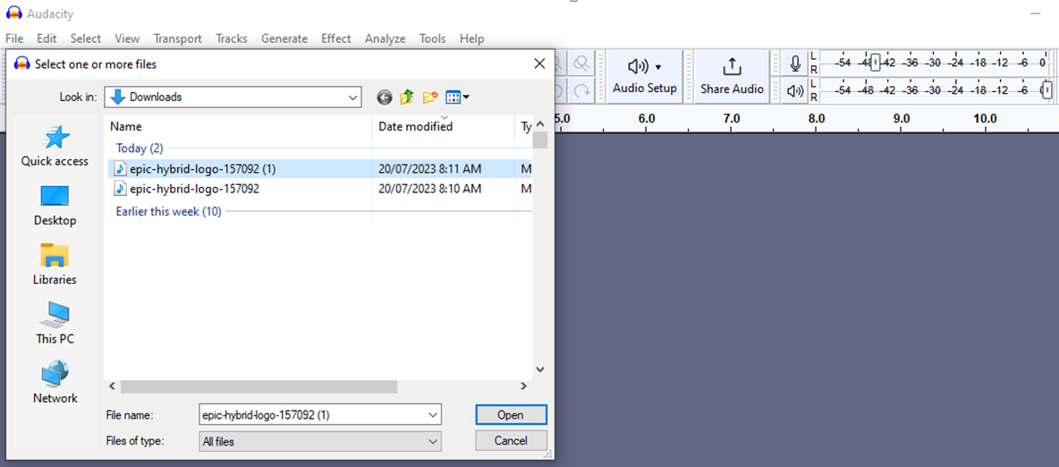
Import an audio file
In the File menu select ‘Import’.
Select the folder that stores the audio file.

Slide 4
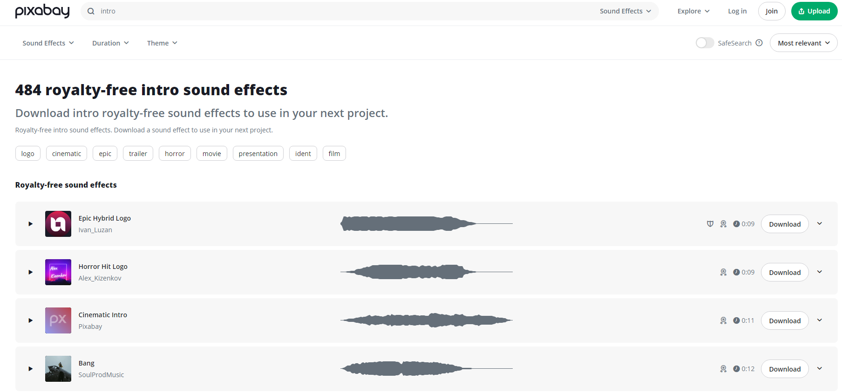
Audio bites
Use royalty free audio bites.
Notes:
https://pixabay.com/sound-effects/search/intro/

Slide 5
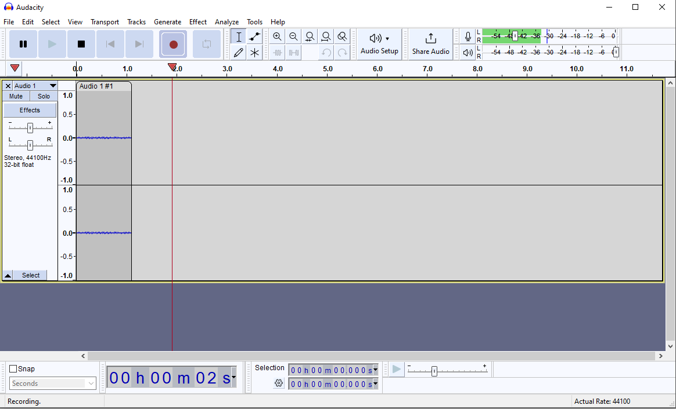
Recording sound
Or use the record button to record sound directly using the software.

Slide 6
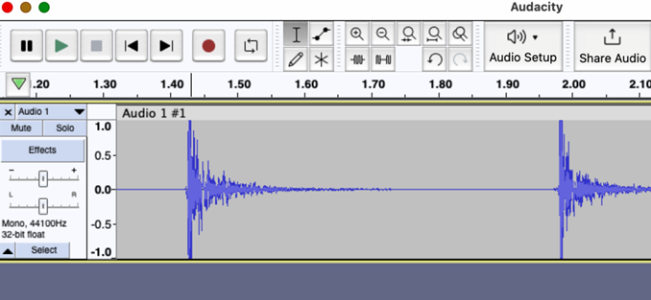
Recording example
This sound of two claps was recorded directly from the laptop microphone.

Slide 7
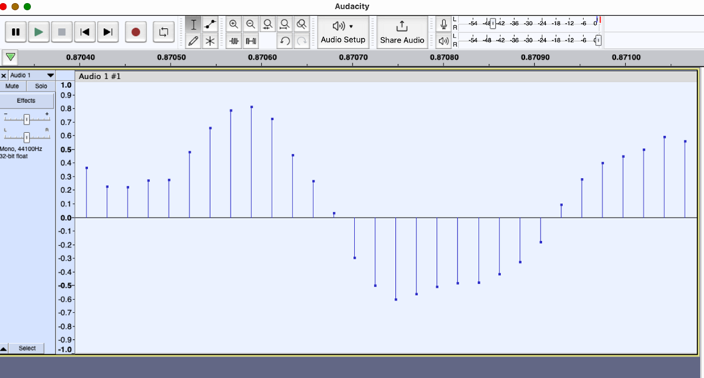
Zoom into sound wave
To get a closer look at the sound wave, use the zoom tool. Click and drag over a portion of the sound wave to zoom in and focus on that area. Continue to zoom until you see this level of detail.

Slide 8
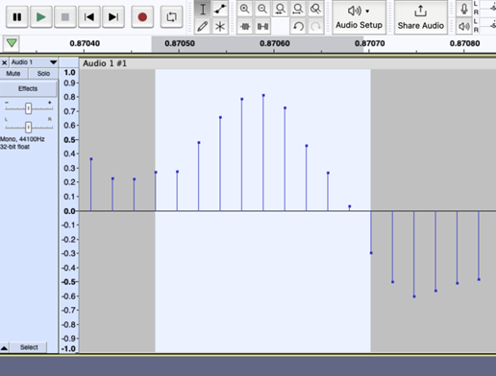
Select a portion of the wave
With the zoomed-in view, use the selection tool, represented by ‘I’. Click and drag to select a small portion of the sound wave.

Slide 9
Scale
A numerical scale for loudness is represented along the side of the waveform display. The arrow is pointing at the amplitude values.

Slide 10
Applying binary representation
Identify the amplitude value
Look at the amplitude value associated with a specific point on the waveform in Audacity. For example, let’s say the amplitude value is 0.8.
Normalise the amplitude
Normalise the amplitude value to a range of 0 to 1. This step is optional but can be helpful for consistency if the amplitude values in Audacity are not already within that range. For example, if the amplitude values in Audacity range from -1 to 1, you can add 1 to the amplitude value and divide it by 2.
In this case:
(0.8 + 1) / 2 = 0.9

Slide 11
Applying binary representation
Convert to binary
Multiply the normalised amplitude value by a suitable factor, such as the maximum value representable by the desired bit depth. Then round the result to the nearest whole number.
For example, if you are using a 4-bit depth, you can multiply 0.9 by 15 (the maximum value representable by 4 bits) to get 13.5. Rounded to the nearest whole number, the result is 14.
Convert the rounded value to its binary representation. In this case, the decimal value 14 can be represented as 1110 in binary.
Repeat the process for other amplitude values.

