Slide 1
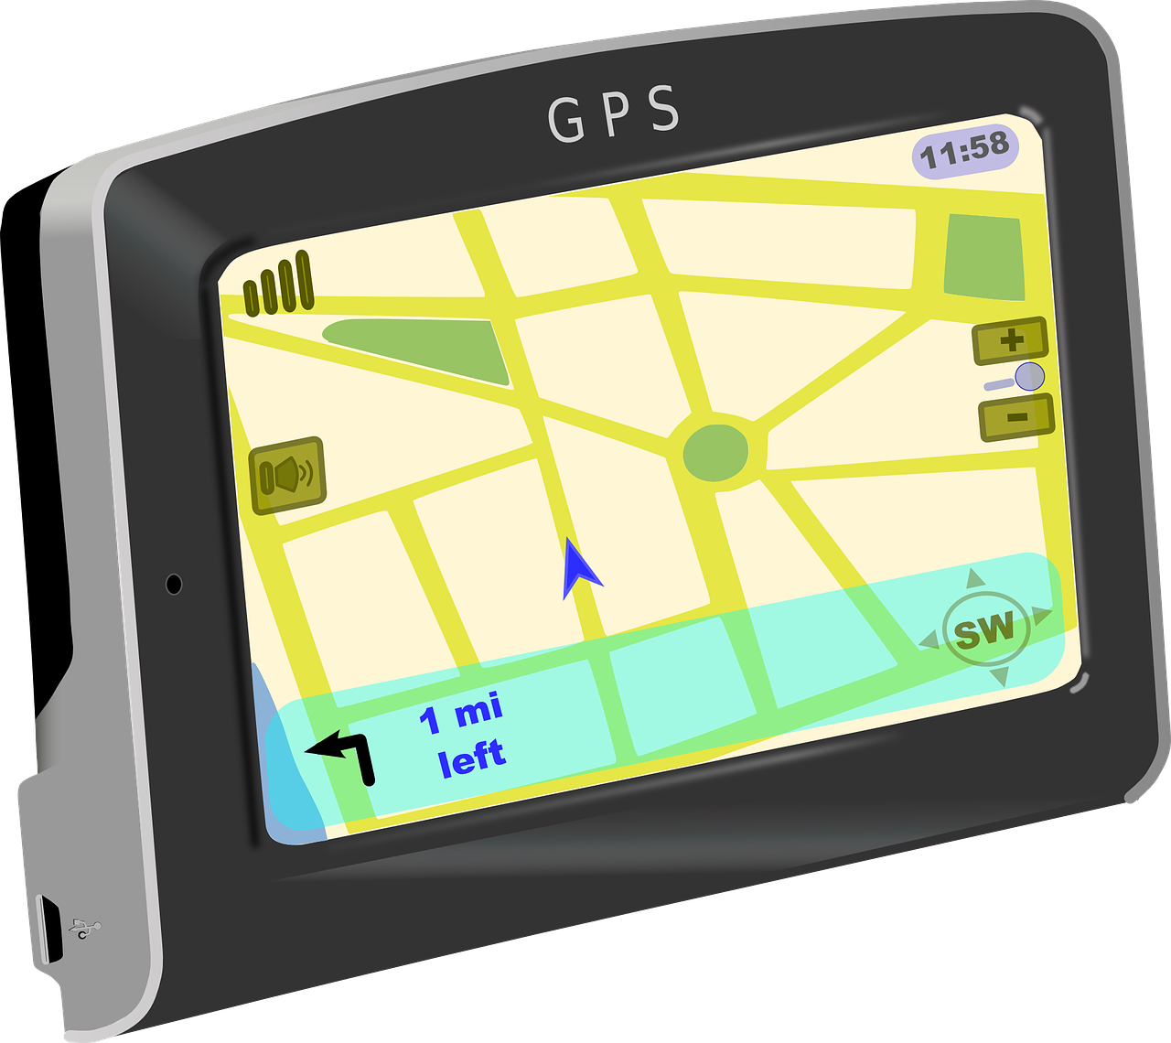
Dynamic route planning
Digital Technologies Hub is brought to you by the Australian Government Department of Education. Creative Commons Attribution 4.0, unless otherwise indicated.
Notes:
https://pixabay.com/vectors/gps-navigation-garmin-device-304842/

Slide 2
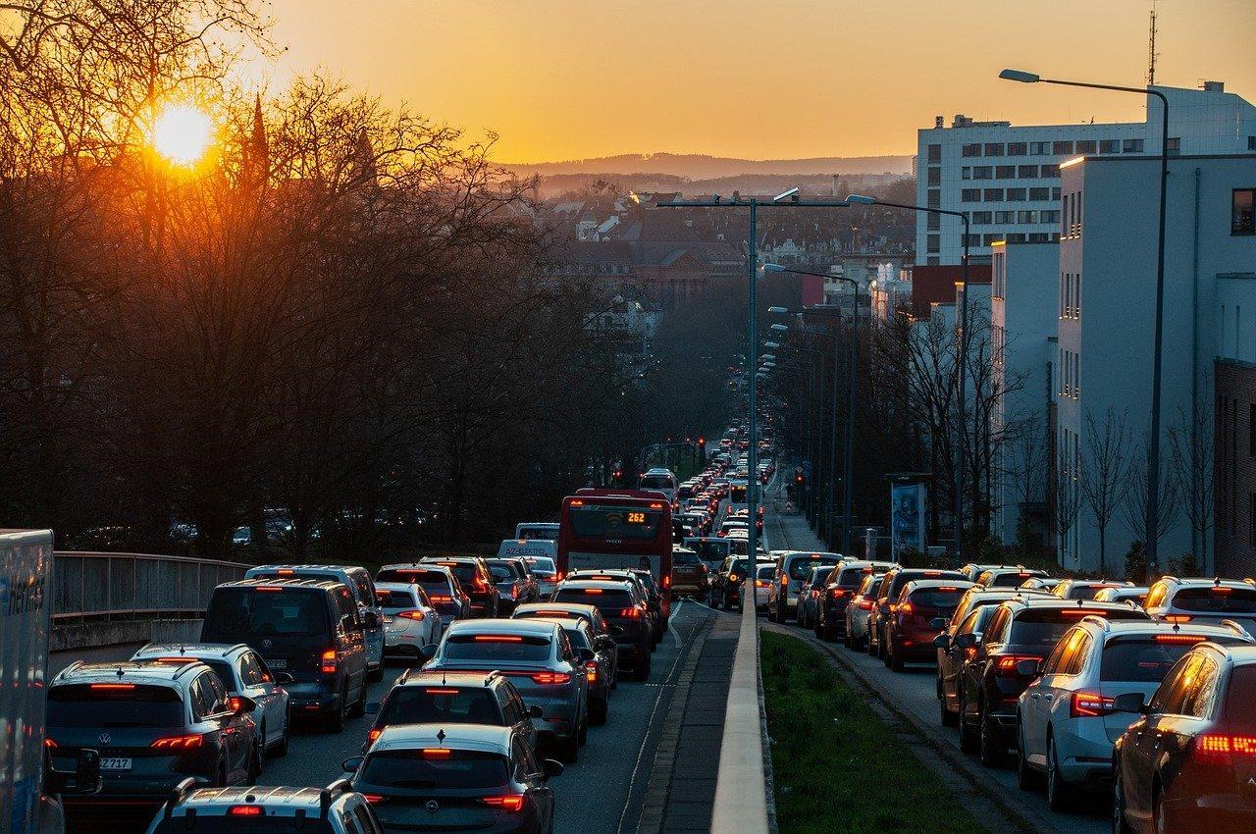
Introduction
Ever wondered how your car navigation system knows the best way to avoid traffic?
Today, we'll explore how AI helps manage traffic and get you to your destination faster!
Source: Pixabay
Digital Technologies Hub is brought to you by the Australian Government Department of Education. Creative Commons Attribution 4.0, unless otherwise indicated.

Slide 3
Learning Objectives
By the end of this lesson, you will:
- understand how AI uses real-time data for navigation
- learn about different types of data AI analyses
- explain how AI adjusts routes based on traffic conditions.
Digital Technologies Hub is brought to you by the Australian Government Department of Education. Creative Commons Attribution 4.0, unless otherwise indicated.

Slide 4
How AI-Powered navigation works
AI in navigation systems uses real-time traffic data and historical patterns to suggest the best routes.
It can quickly adjust your route if it detects traffic jams, accidents or road closures ahead.
Digital Technologies Hub is brought to you by the Australian Government Department of Education. Creative Commons Attribution 4.0, unless otherwise indicated.

Slide 5
Scenario: Route recalculation
Imagine you're on a road trip with your family, and suddenly, your navigation systems says 'route recalculation'.
What does that mean?
Why might it happen?
Route recalculation!
Digital Technologies Hub is brought to you by the Australian Government Department of Education. Creative Commons Attribution 4.0, unless otherwise indicated.

Slide 6
Data sources for traffic analysis
AI needs lots of data to make smart decisions about traffic.
Can you think of important data sources that would be needed?
Here are some important data sources:
Traffic cameras
Road sensors
GPS devices in vehicles
Historical traffic data
Social media posts
Weather reports
Digital Technologies Hub is brought to you by the Australian Government Department of Education. Creative Commons Attribution 4.0, unless otherwise indicated.
Notes:
Answers appear on mouse click Here are some important data sources:
Traffic cameras
Road sensors
GPS devices in vehicles
Historical traffic data
Social media posts
Weather reports

Slide 7
Introduce a flowchart
Now, let's create a flowchart to see how AI makes decisions about changing your route.
We'll look at each step AI takes to find the best way around traffic problems.
But first lets look at an example flowchart.
Digital Technologies Hub is brought to you by the Australian Government Department of Education. Creative Commons Attribution 4.0, unless otherwise indicated.

Slide 8
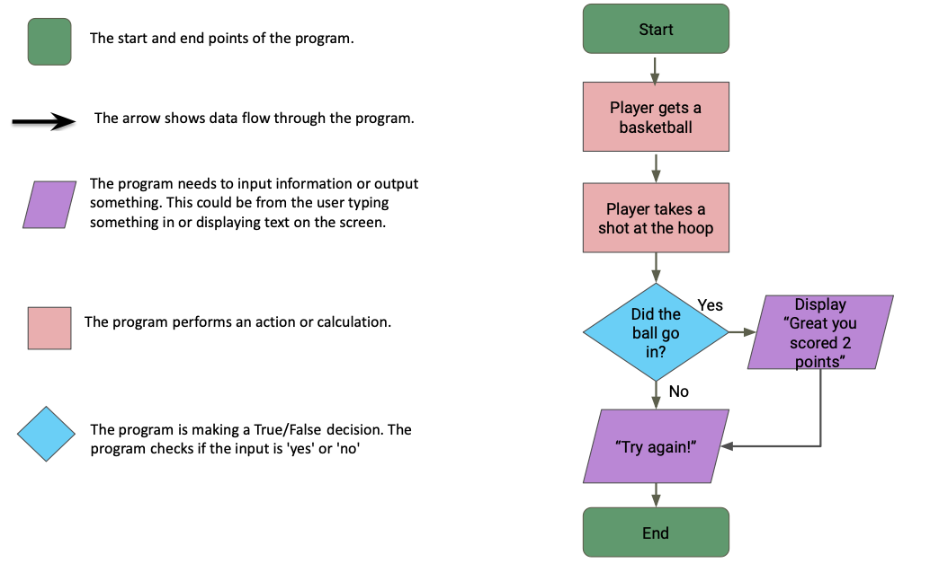
Example flowchart
Digital Technologies Hub is brought to you by the Australian Government Department of Education. Creative Commons Attribution 4.0, unless otherwise indicated.

Slide 9
Interactive flowchart activity
Imagine you're designing an AI for a navigation app.
Your AI needs to decide if it should change the route because of an accident.
Create a simple flowchart showing how your AI would make this decision.
Digital Technologies Hub is brought to you by the Australian Government Department of Education. Creative Commons Attribution 4.0, unless otherwise indicated.

Slide 10
Possible solution: (written as steps)
Start
Step1. Receive traffic data
Is there an accident reported ahead?
Yes: Proceed to Step 2
No: Continue on current route
Step 2. Evaluate traffic conditions
Is the accident causing significant traffic congestion?
Yes: Proceed to Step 3
No: Continue on current route
Step 3. Check alternative routes
Are there alternative routes available?
Yes: Proceed to Step 4
No: Continue monitoring current route
Step 4. Calculate optimal route
Analyse real-time traffic data and historical patterns
Consider factors: road closures, construction sites, and traffic flow
Determine the most efficient alternative route
Update route recommendation
Step 5. Communicate route change
Notify user of new route recommendation
Provide estimated arrival time based on new route
Continue to monitor traffic conditions
End
Digital Technologies Hub is brought to you by the Australian Government Department of Education. Creative Commons Attribution 4.0, unless otherwise indicated.

Slide 11
Conclusions
AI makes our lives easier by helping us avoid traffic and get to our destinations faster.
By understanding how AI works, we can appreciate the technology we use every day.
Digital Technologies Hub is brought to you by the Australian Government Department of Education. Creative Commons Attribution 4.0, unless otherwise indicated.

