Slide 1



Detecting phishing scams
Digital Technologies Hub is brought to you by the Australian Government Department of Education. Creative Commons Attribution 4.0, unless otherwise indicated.
Notes:
https://pixabay.com/vectors/cybersecurity-computer-security-6949298/

Slide 2
What is phishing?
Have you heard of the term: phishing?
What do you think it means?
Where might it be mentioned?
A fraudulent practice of sending non-targeted emails asking people to reveal sensitive data such as bank details or encouraging people to open a malicious attachment or download malicious content.
Digital Technologies Hub is brought to you by the Australian Government Department of Education. Creative Commons Attribution 4.0, unless otherwise indicated.
Notes:
Animated text on click
A fraudulent practice of sending non-targeted emails asking people to reveal sensitive data such as bank details or encouraging people to open a malicious attachment or download malicious content.

Slide 3
What is a scam ?
A scam is a dishonest scheme or fraud, typically for financial gain.
A phishing scam combines the elements of phishing and a scam.
  It involves the fraudulent practice of sending emails or messages that appear to be from reputable sources.
  Aimed to deceive recipients into revealing sensitive personal information (such as passwords, credit card numbers, or bank details).
  Or into performing actions that compromise their security (such as opening a malicious attachment, downloading harmful content, or clicking on a link).
Digital Technologies Hub is brought to you by the Australian Government Department of Education. Creative Commons Attribution 4.0, unless otherwise indicated.

Slide 4
What is a spoofing ?
Spoofing is when someone pretends to be someone else to trick you.
Can you think of some examples of spoofing?
A person pretending to represent a company or government agency such as the ATO
A phone call from someone pretending to be from a bank asking for your password details but it’s really a scammer
A text from a person claiming to be a stranded family member asking for money to get home
Digital Technologies Hub is brought to you by the Australian Government Department of Education. Creative Commons Attribution 4.0, unless otherwise indicated.

Slide 5
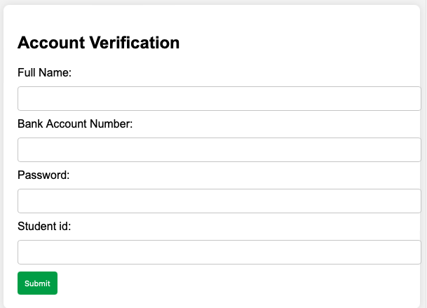
A typical phishing scam email:
Dear Customer,
We regret to inform you that your account has been suspended due to suspicious activities. To regain access, please verify your information immediately by click on the link below:
Verify Your Account
Failure to do so within 24 hours will result in permanent suspension of your account.
Best regards,
Security Team
BankOfTrust@securemail.com
http://fakeurl.com
Digital Technologies Hub is brought to you by the Australian Government Department of Education. Creative Commons Attribution 4.0, unless otherwise indicated.

Slide 6
What are the typical characteristics?
1. Sender’s email address does not match the official domain: The email is sent from “BankOfTrust@securemail.com” instead of an official bank domain.
2. Signs of email spoofing: The email attempts to impersonate a legitimate entity but uses a generic and suspicious email domain.
3. Grammar or spelling errors: The content is written in a rush and may contain grammatical mistakes.
4. Urgent requests or threats: The email contains an urgent threat of account suspension to prompt immediate action.
Dear Customer,
We regret to inform you that your account has been suspended due to suspicious activities. To regain access, please verify your information immediately by click on the link below:
Verify Your Account
Failure to do so within 24 hours will result in permanent suspension of your account.
Best regards,
Security Team
BankOfTrust@securemail.com
Digital Technologies Hub is brought to you by the Australian Government Department of Education. Creative Commons Attribution 4.0, unless otherwise indicated.

Slide 7
How can a computer detect it?
IF sender's email address does not match official domain
THEN flag email as phishing scam and END
ELSE IF there are signs of email spoofing
THEN flag email as phishing scam and END
ELSE IF there are grammar or spelling errors
THEN flag email as phishing scam and END
ELSE IF email contains urgent requests or threats
THEN flag email as phishing scam and END
ELSE
flag email as legitimate email and END
END
Digital Technologies Hub is brought to you by the Australian Government Department of Education. Creative Commons Attribution 4.0, unless otherwise indicated.

