Slide 1


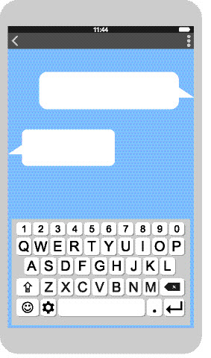
Exploring predictive text
I'm going to be late
Ok I will
wait
walk
cry
Image source: vector portal
Digital Technologies Hub is brought to you by the Australian Government Department of Education. Creative Commons Attribution 4.0, unless otherwise indicated.
Notes:
Image source: vector portal

Slide 2
Predicting what word comes next #1
a _____.
Digital Technologies Hub is brought to you by the Australian Government Department of Education. Creative Commons Attribution 4.0, unless otherwise indicated.
Notes:
Ask students to predict the next word.
This will be challenging to predict the correct word as there is no context.

Slide 3
Predicting what word comes next #2
Pick a
to win a _____.
Digital Technologies Hub is brought to you by the Australian Government Department of Education. Creative Commons Attribution 4.0, unless otherwise indicated.
Notes:
Provide a bit more context
Another word is covered up by the blue rectangle

Slide 4
Predicting what word comes next #3
Pick a number to win a ____
Digital Technologies Hub is brought to you by the Australian Government Department of Education. Creative Commons Attribution 4.0, unless otherwise indicated.
Notes:
Reveal the word covered by the blue rectangle .

Slide 5
Predicting what word comes next #4
Pick a number to win a prize.
Which words helped you predict the correct word?
We can reduce the words to a few important ones.
Digital Technologies Hub is brought to you by the Australian Government Department of Education. Creative Commons Attribution 4.0, unless otherwise indicated.
Notes:
We can reduce the words to a few important ones.
An AI does the same thing to predict the next word quickly

Slide 6
Exploring a text message
What three words are predicted to complete the text message?
We call this autocomplete.
I'm going to be late
Ok I will
wait
walk
cry
Image source: vector portal
Digital Technologies Hub is brought to you by the Australian Government Department of Education. Creative Commons Attribution 4.0, unless otherwise indicated.
Notes:
Image source: vector portal

Slide 7
How does it work?
Predictive text is a technology that suggests words based on what is being typed.
It uses language models to predict the next word or phrase.
I'm going to be late
Ok I will
wait
walk
cry
Digital Technologies Hub is brought to you by the Australian Government Department of Education. Creative Commons Attribution 4.0, unless otherwise indicated.
Notes:
Image source: vector portal

Slide 8
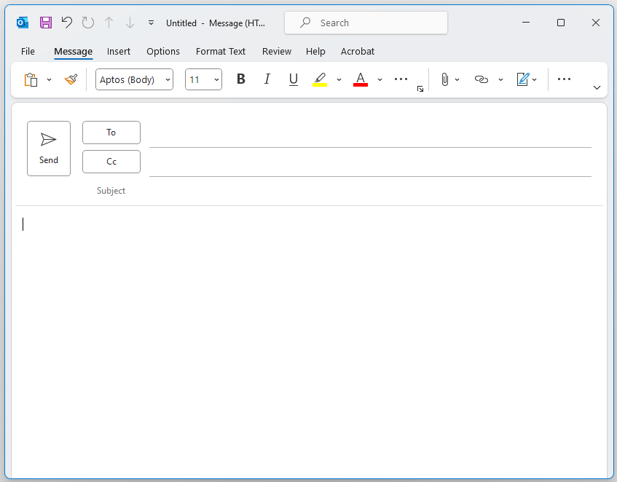
Email with predictive responses
Some email applications use AI to predict responses.
What might the AI predict your response to be?
U/12 basketball team
Thursday night training
To U/12 basketball team players
Don't forget Thursday night training
Bring a water bottle!
See you there.
A1 coach
Digital Technologies Hub is brought to you by the Australian Government Department of Education. Creative Commons Attribution 4.0, unless otherwise indicated.

Slide 9
Choosing predictive responses
Predictive responses:​
1. Thanks for the reminder.​
2. I'll be there!
3. Sorry, I can't make it.
U/12 basketball team
Thursday night training
To U/12 basketball team players
Don't forget Thursday night training
Bring a water bottle!
See you there.
A1 coach
Digital Technologies Hub is brought to you by the Australian Government Department of Education. Creative Commons Attribution 4.0, unless otherwise indicated.

Slide 10
Summary
Predictive text is a powerful tool it:
- Increases typing speed and efficiency.
- Helps reduce spelling errors.
- Enhances accessibility for users.
I'm going to be late
Ok I will
wait
walk
cry
Digital Technologies Hub is brought to you by the Australian Government Department of Education. Creative Commons Attribution 4.0, unless otherwise indicated.
Notes:
Image source: vector portal

