Slide 1
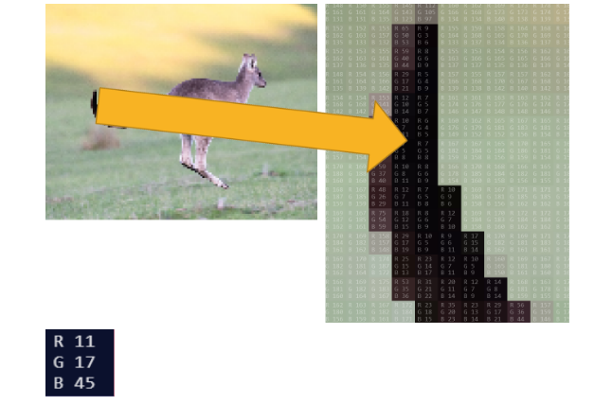
What do you notice and wonder?

